Slide 1
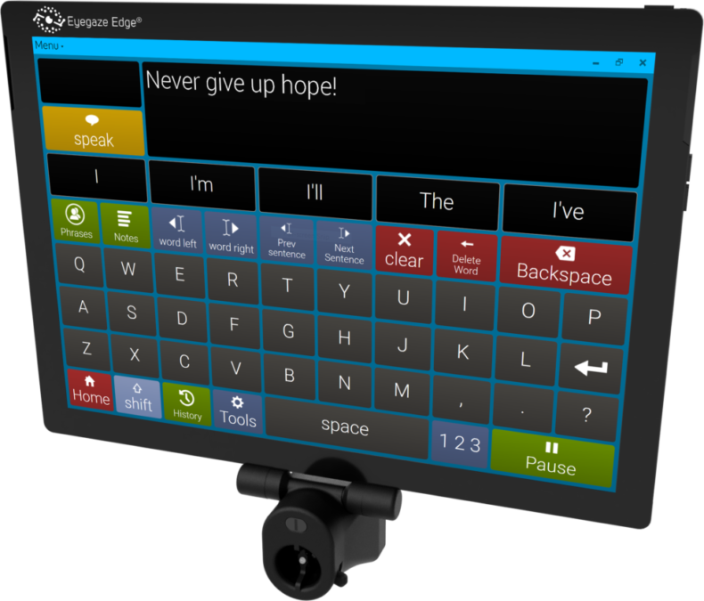

Eye-Gaze
Control System
NAID Project

Slide 2
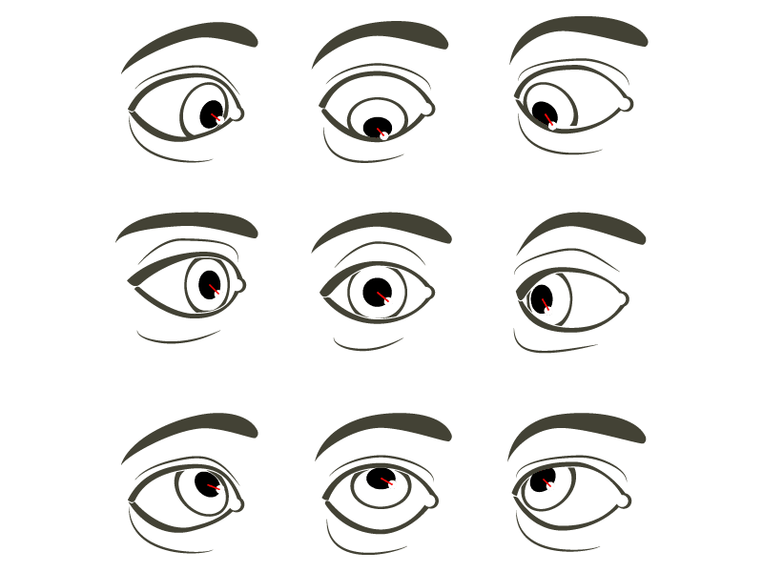

Overview
Our Team
01
Introduction
02
Our Services
03
Strategy
04
Experience
05
Project Timeline
06
Strategy
07
Our Mision
08

Slide 3
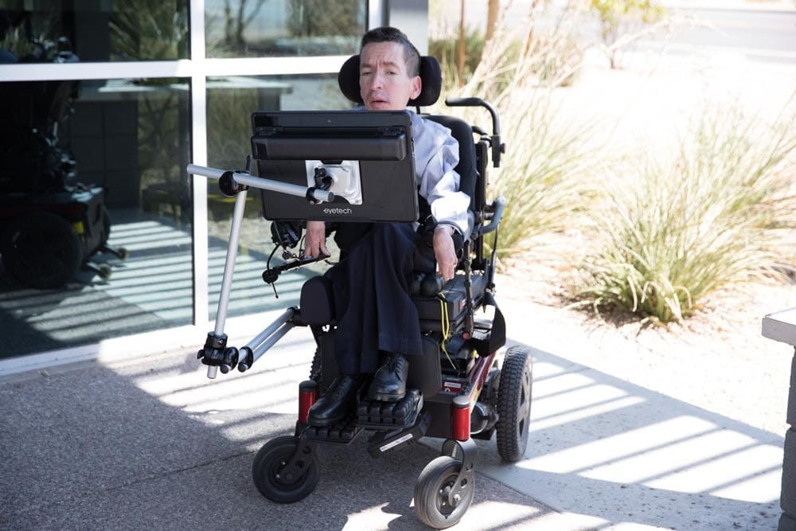
Problem Statement
& Motivation
Quadriplegic patients face one of the most challenging disabilities, where they lose control over almost their entire body.
In many cases, the only movement they can control is their eyes.

Slide 4
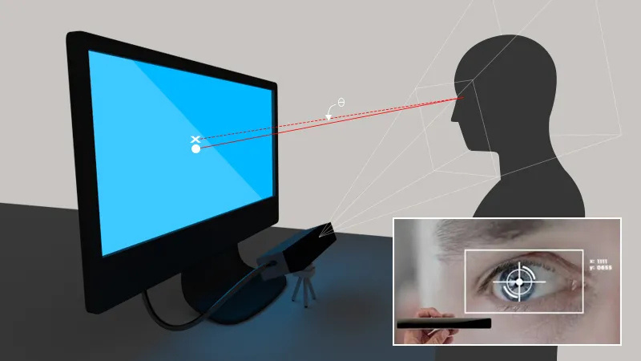
Business Model
Proof of Concept
A preliminary prototype has been developed.
Successfully detects eye movements.
Enables users to type simple words (e.g., “Hello”).
Demonstrates the feasibility and scalability of the solution.

Slide 5
Time Plan & Deliverables
Phase 1:
Literature review & system design
(2 Weeks)
Phase 2:
Prototype development (hardware + software)
(5 Weeks)
Phase 3:
User testing, feedback, and refinement
(1 Weeks)
In Total: 2 Months
Deliverables:
Functional low-cost prototype
Detailed project report

Slide 6
Time Plan & Deliverables
Target Customers
Institutions: Hospitals, NGOs, Rehabilitation centers
Individuals: Patients & families
Revenue Streams
Direct device sales
Maintenance & support services
Future subscriptions (advanced voice, predictive NLP upgrades)
Go-to-Market Strategy
Partnerships with healthcare institutions
Affordable pricing for individuals

Slide 7
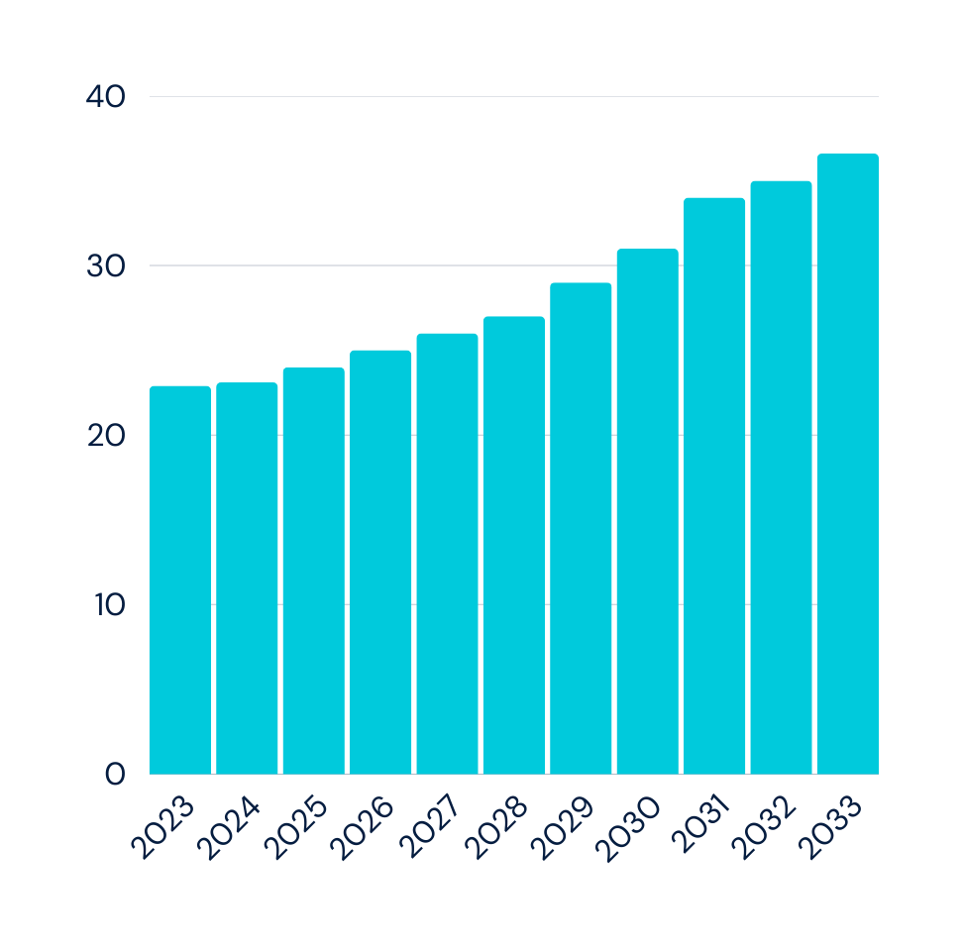
Market Overview (Global AT Market Growth)
The global assistive technology market is expanding significantly. It reached around USD 22.9 billion in 2023 and is projected to grow to USD 36.6 billion by 2033, with a steady CAGR of 4.8%. This robust growth reflects the rising need for accessibility solutions worldwide.

Slide 8
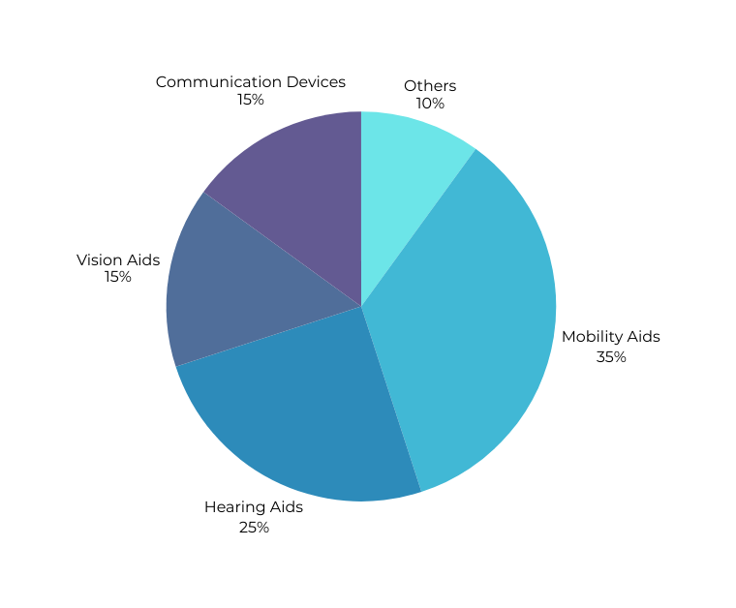
Market Analysis – Global
The Global Assistive Technology Market was valued at ~$22B in 2023 and is projected to grow to ~$35B by 2030 (CAGR ~6%).
Eye-tracking AAC solutions represent a high-demand niche within this market.
Current prices for commercial AAC bundles can reach $5,000–$10,000, creating a large opportunity for affordable, localized alternatives.

Slide 9

Budget Breakdown
Our estimated budget is $700, with the main expense being the eye-tracking camera and testing resources.
This provides a cost-effective alternative compared to commercial systems priced up to $10,000.

Slide 10
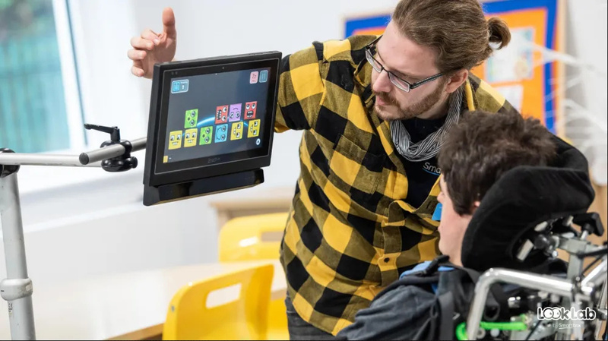
Market Gap & Local Potential (Egypt/MENA & Eye Tracking Costs)
In Egypt and the wider MENA region, advanced assistive technologies—particularly eye-tracking communication systems—remain limited due to high costs and low availability. Full packages can cost around USD 10,000, while simplified gaming models cost USD 300–400. This large price gap reveals a major market opportunity, as many individuals with severe motor impairments could benefit from an affordable, locally-developed solution.

Slide 11
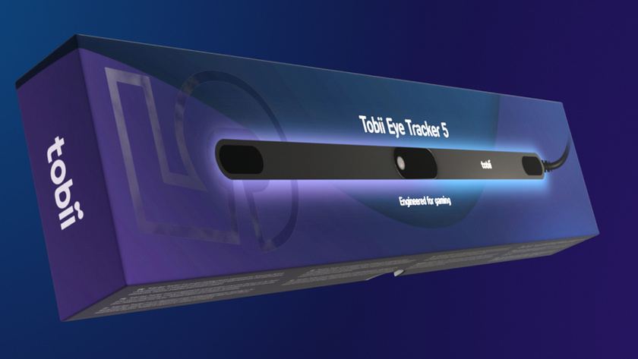
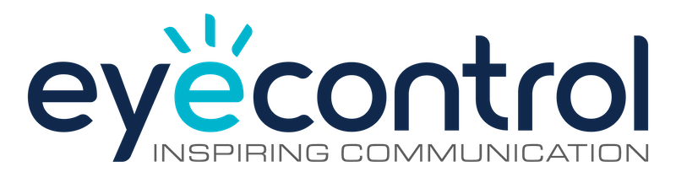
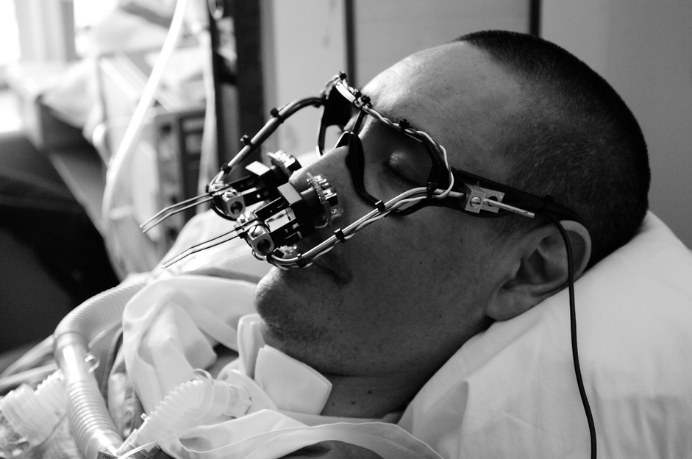
Literature Review
Our research reviewed existing assistive technologies, including Tobii Eye Tracker, EyeWriter, and EyeControl.
These solutions demonstrate the potential of eye-tracking systems for communication.
However, the main drawbacks are:
Cost: Ranges from a few hundred dollars (gaming trackers) up to several thousand USD when bundled with AAC software, mounts, and support services.
Accessibility: Limited availability in developing countries, especially with Arabic language support.

Slide 12
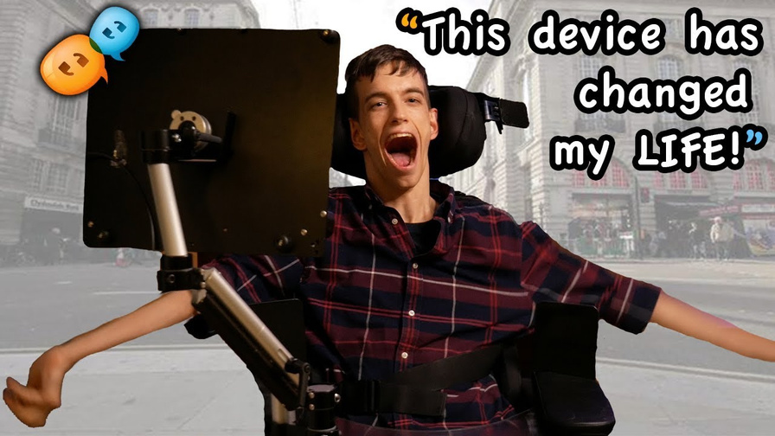
Proposed Solution
We propose a low-cost eye-based communication system that enables patients to interact with a computer using their eye movements.
Gaze detection to select letters.
Converts selections into text
Supports English, Arabic, Numbers,and Symbols for wider accessibility
Abiitity to control Camera sensitivity to set it on your favorite way
Affordable & inclusive, designed for local communities
This solution enables patients to communicate naturally and independently at a fraction of the current costs.

Slide 13
Methods & Technical Approach
Our system combines affordable hardware with open-source software:
Eye Tracking: A Webcam captures eye movements.
Computer Vision: Algorithms detect gaze direction and translate it into actions
Accessible Interface: Large icons, simple layouts, multi options (English, Arabic, Symbols, and Numbers).
This approach ensures the system is low-cost, accurate, and user-friendly.
Eye Movement
Camara
Gaze Algorithm
Output (Text)

Slide 14
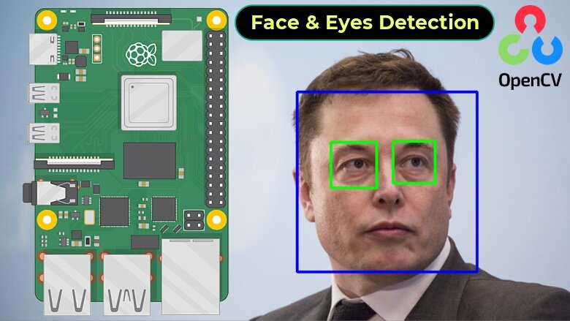
Resources Needed
Software:
OpenCV
dlib
Hardware:
Webcam/camera
Other Resources:
Lab facilities for testing
Affordable – based on open-source tools
Feasible – uses readily available hardware

Slide 15
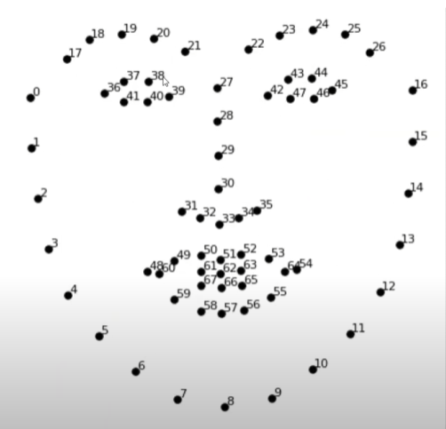
Main Core of Project
Landmarks used in dlib

Slide 16
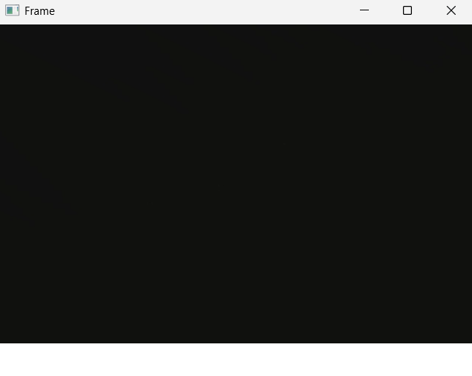
Project Interface
Live stream of your face
white bar tells if you are blinking or not (become gray if you are blinking)

Slide 17
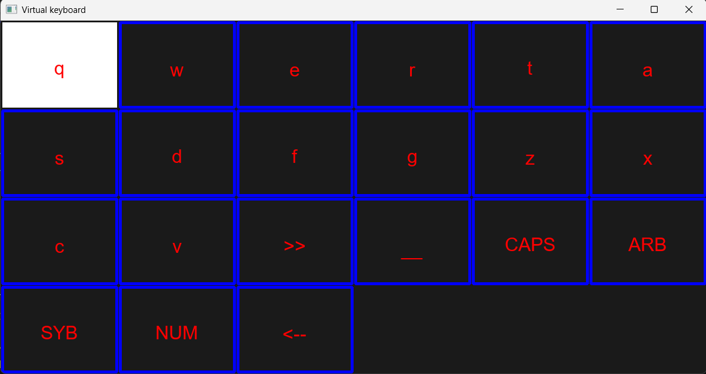
Project Interface

Slide 18
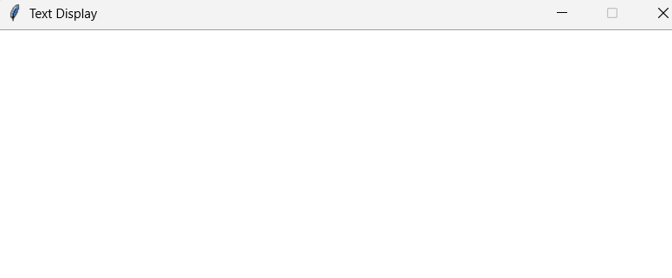
Project Interface
Text Box to view the text you typed

Slide 19
SWOT Analysis
Strengths | Weaknesses
Affordable, localized, supports Arabic & English | Lower precision vs. high-end devices
Opportunities | Threats
Growing demand for assistive tech in Egypt & MENA | Strong competition from global brands

Slide 20
Feature Improvments
Add suggested words feature to help writing speed.
Add grammer & word checker
Make the person not only can write on keyboard, but also choose icons and interact with whole system as he\she has mouse.

Slide 21
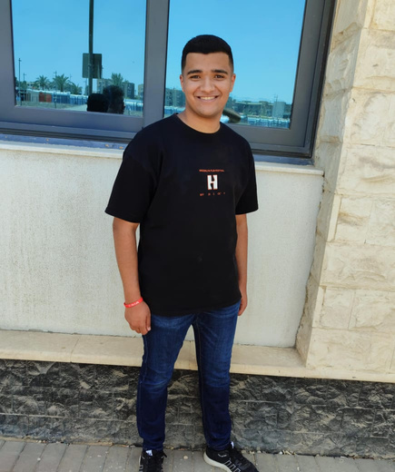

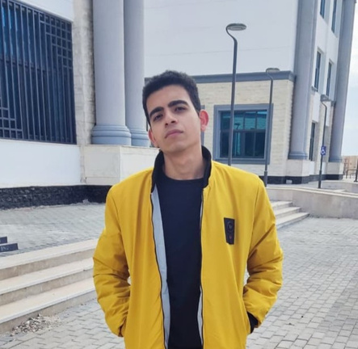
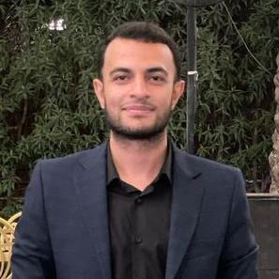

Our Team
Ahmed Saad
Ahmed Yasser
Kirillus Emad
Ismail Elhitami
Ismail Elyan
UI/UX & Product Designer
Project Manager & Team Leader
Software Engineer
Data Analysis
Technical Lead

Slide 22
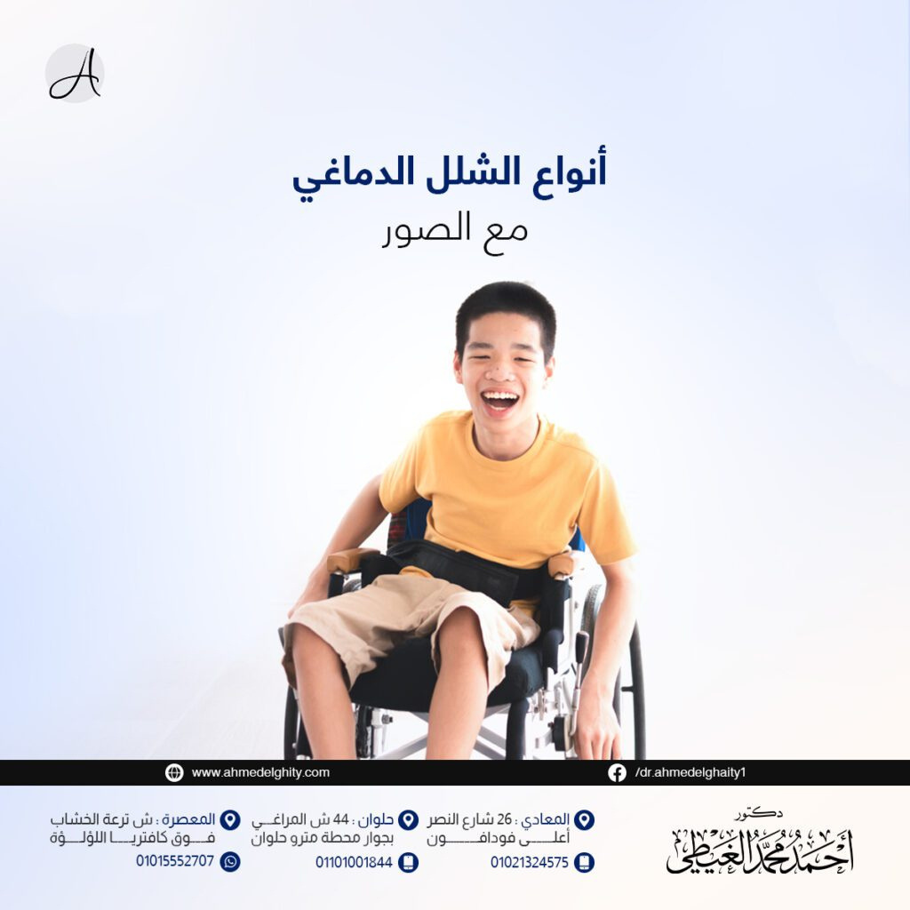

THANK YOU!

